Slide 1
ISAP: The History of a Significant Society
Tom C. Krejcie, MD
Professor of Anesthesiology and
Associate Chief Medical Officer
October 21, 2016

Slide 2
The Essence of Clinical Pharmacology
CP&T July 2007
All substances are poisons;
there is none which is not a poison. The right dose differentiates
a poison and a remedy.
Paracelsus (1493-1541)
Theophrastus Phillippus Aureolus
Bombastus von Hohenheim
This thought was generated 500 years ago and it is my contention that these words encompass the Holy Grail of Clinical Pharmacology. How to determine that dose, route of administration, and dosing frequency is what we are all striving for.

Slide 3
ISAP: The History of a Significant Society
Past Presidents
1990-1991 | 2000-2001 | 2009
Elemer Zsigmond, MD | James G. Bovill, MD, PhD, FCARCSI | Thomas Schnider, MD
University of Illinois, Chicago | Uithoorn, The Netherlands | Institut für Anästhesiologie, St Gallen, Switzerland
1993 | 2002 | 2010
Tony Ivankovich, MD | John W. Sear, MA, BSc, MBBS, PhD, FFARCS, FANZCA | Pamela Flood, MD
Rush University Medical Center, Chicago | University of Oxford, UK | Columbia University
1994 | 2003 | 2011
Ted Stanley, MD | Tony Gin, MD, FANZCA | Thomas K. Henthorn, MD
University of Utah | Chinese University of Hong Kong | University of Colorado - Denver
1995 | 2004 | 2012
Peter Sebel, MBBS, PhD, MBA | Adrian W. Gelb, MB, ChB | Tom C. Krejcie, MD
Emory University, Atlanta Georgia | University of California, San Francisco | Northwestern University
1996 | 2005 | 2013
Peter Glass, MD | Talmage D. Egan, MD | Ken B. Johnson, MD
Stony Brook University, New York | University of Utah | University of Utah
1997 | 2006 | 2014
Kenneth J. Tuman, MD | Steven L. Shafer, MD | Yuguang Huang, MD
Rush University Medical Center, Chicago | Stanford University | Peking Union Medical College Hospital
1998 | 2007 | 2015
Michael B. Howie, MD | Michel Struys, MD, PhD | James M. Sonner, MD
The Ohio State University | University Medical Center Groningen, The Netherlands | University of California - San Francisco
1999 | 2008 | 2016
Paul White, MD | Tong J. Gan, MD | Vesna Jevtovic-Todorovic, MD, PhD, MBA
University of Texas | Duke University | University of Colorado - Denver

Slide 4
ISAP: The History of a Significant Society
Past Presidents
1990-1991 | 2000-2001 | 2009
Elemer Zsigmond, MD | James G. Bovill, MD, PhD, FCARCSI | Thomas Schnider, MD
University of Illinois, Chicago | Uithoorn, The Netherlands | Institut für Anästhesiologie, St Gallen, Switzerland
1993 | 2002 | 2010
Tony Ivankovich, MD | John W. Sear, MA, BSc, MBBS, PhD, FFARCS, FANZCA | Pamela Flood, MD
Rush University Medical Center, Chicago | University of Oxford, UK | Columbia University
1994 | 2003 | 2011
Ted Stanley, MD | Tony Gin, MD, FANZCA | Thomas K. Henthorn, MD
University of Utah | Chinese University of Hong Kong | University of Colorado - Denver
1995 | 2004 | 2012
Peter Sebel, MBBS, PhD, MBA | Adrian W. Gelb, MB, ChB | Tom C. Krejcie, MD
Emory University, Atlanta Georgia | University of California, San Francisco | Northwestern University
1996 | 2005 | 2013
Peter Glass, MD | Talmage D. Egan, MD | Ken B. Johnson, MD
Stony Brook University, New York | University of Utah | University of Utah
1997 | 2006 | 2014
Kenneth J. Tuman, MD | Steven L. Shafer, MD | Yuguang Huang, MD
Rush University Medical Center, Chicago | Stanford University | Peking Union Medical College Hospital
1998 | 2007 | 2015
Michael B. Howie, MD | Michel Struys, MD, PhD | James M. Sonner, MD
The Ohio State University | University Medical Center Groningen, The Netherlands | University of California - San Francisco
1999 | 2008 | 2016
Paul White, MD | Tong J. Gan, MD | Vesna Jevtovic-Todorovic, MD, PhD, MBA
University of Texas | Duke University | University of Colorado - Denver

Slide 5
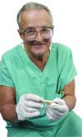
From Humble Beginnings: SONLA The Society for NeuroLeptAnalgesia
Elemer (Elmer) K. Zsigmond, MD May 16, 1930 – April 5, 2012
In the late 1980s, a group of academicians had a special interest in neurolept anesthesia
Neurolept anesthesia results when combining a major neuroleptic tranquilizer/antipsychotic (typically the potent dopamine-2 receptor antagonist, droperidol) and the potent opioid analgesic fentanyl (Innovar) to produce a detached, pain-free state
These anesthesiologists from the University of Illinois Medical Center and the Rush Medical Center in Chicago got together to form the Society for NeuroLeptAnalgesia - SONLA

Slide 6
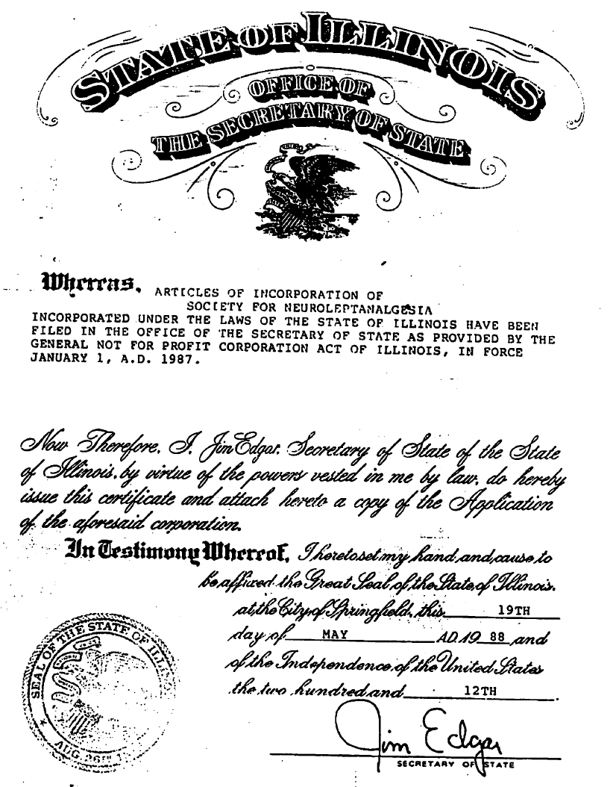
From Humble Beginnings: SONLA The Society for NeuroLeptAnalgesia
19 May 1988

Slide 7
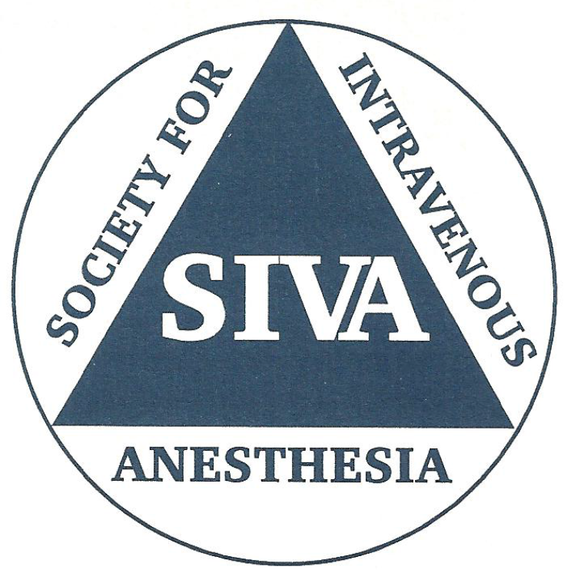
From SONLA to SIVA: The History of Anaesthesic Pharmacology
Elemer (Elmer) K. Zsigmond, MD
First President of the Society serving in 1990 and 1991
While the patients receiving neurolept-analgesia were in a detached, pain-free state, some, but not all, patients were amnestic.
Therefore, with the subsequent virtual demise of neurolept anesthesia but continued interest in the multiple forms of total intravenous anesthesia , Dr. Zsigmond approached his friends Peter Sebel (Emory) and Tony Ivankovich (Rush) about expanding the subject matter of the society.

Slide 8
From SONLA to SIVA: The History of Anaesthesic Pharmacology
Past Presidents
1990-1991 | 2000-2001 | 2009
Elemer Zsigmond, MD | James G. Bovill, MD, PhD, FCARCSI | Thomas Schnider, MD
University of Illinois, Chicago | Uithoorn, The Netherlands | Institut für Anästhesiologie, St Gallen, Switzerland
1993 | 2002 | 2010
Tony Ivankovich, MD | John W. Sear, MA, BSc, MBBS, PhD, FFARCS, FANZCA | Pamela Flood, MD
Rush University Medical Center, Chicago | University of Oxford, UK | Columbia University
1994 | 2003 | 2011
Ted Stanley, MD | Tony Gin, MD, FANZCA | Thomas K. Henthorn, MD
University of Utah | Chinese University of Hong Kong | University of Colorado - Denver
1995 | 2004 | 2012
Peter Sebel, MBBS, PhD, MBA | Adrian W. Gelb, MB, ChB | Tom C. Krejcie, MD
Emory University, Atlanta Georgia | University of California, San Francisco | Northwestern University
1996 | 2005 | 2013
Peter Glass, MD | Talmage D. Egan, MD | Ken B. Johnson, MD
Stony Brook University, New York | University of Utah | University of Utah
1997 | 2006 | 2014
Kenneth J. Tuman, MD | Steven L. Shafer, MD | Yuguang Huang, MD
Rush University Medical Center, Chicago | Stanford University | Peking Union Medical College Hospital
1998 | 2007 | 2015
Michael B. Howie, MD | Michel Struys, MD, PhD | James M. Sonner, MD
The Ohio State University | University Medical Center Groningen, The Netherlands | University of California - San Francisco
1999 | 2008 | 2016
Paul White, MD | Tong J. Gan, MD | Vesna Jevtovic-Todorovic, MD, PhD, MBA
University of Texas | Duke University | University of Colorado - Denver

Slide 9
SIVA: The Birth of a New Society
The new society became the Society for IntraVenous Anesthesia (SIVA)
The first annual meeting of SIVA was held in conjunction with the
annual ASA meeting in New Orleans on October 16, 1992
The meeting course directors were Peter Sebel and Peter Glass
Meeting abstracts, membership dues and meeting registration were to be
sent to Ken Tuman at Rush
The Society for Intravenous Anesthesia has been established to
advance the understanding and international communication among
scientists of various backgrounds facilitating integration of clinical and
basic research directed at intravenous anesthesia and analgesia. It
further seeks to promote education in anesthesia and analgesia.

Slide 10
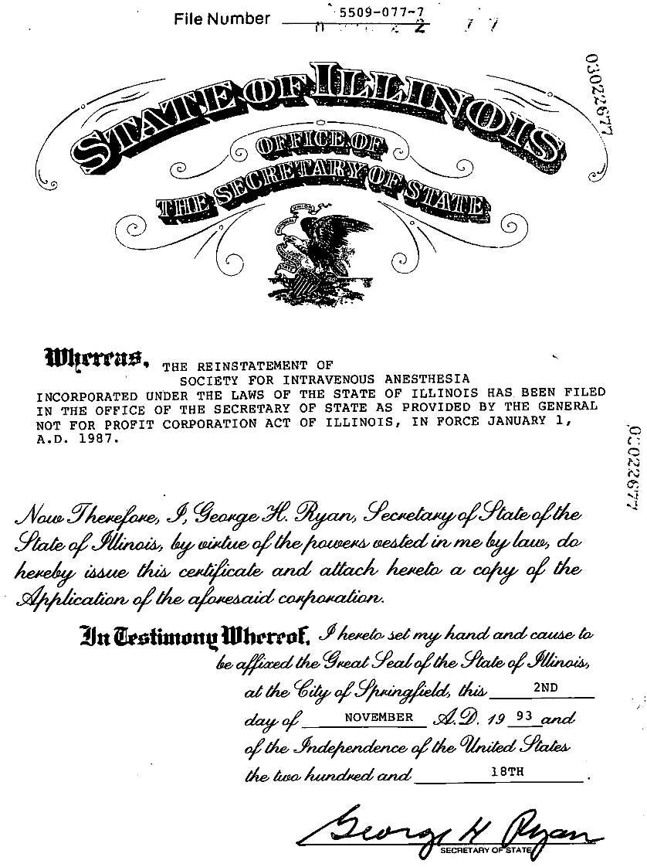
SIVA: The Birth of a New Society
2 November 1993

Slide 11
SIVA: The Birth of a New Society
Past Presidents
1990-1991 | 2000-2001 | 2009
Elemer Zsigmond, MD | James G. Bovill, MD, PhD, FCARCSI | Thomas Schnider, MD
University of Illinois, Chicago | Uithoorn, The Netherlands | Institut für Anästhesiologie, St Gallen, Switzerland
1993 | 2002 | 2010
Tony Ivankovich, MD | John W. Sear, MA, BSc, MBBS, PhD, FFARCS, FANZCA | Pamela Flood, MD
Rush University Medical Center, Chicago | University of Oxford, UK | Columbia University
1994 | 2003 | 2011
Ted Stanley, MD | Tony Gin, MD, FANZCA | Thomas K. Henthorn, MD
University of Utah | Chinese University of Hong Kong | University of Colorado - Denver
1995 | 2004 | 2012
Peter Sebel, MBBS, PhD, MBA | Adrian W. Gelb, MB, ChB | Tom C. Krejcie, MD
Emory University, Atlanta Georgia | University of California, San Francisco | Northwestern University
1996 | 2005 | 2013
Peter Glass, MD | Talmage D. Egan, MD | Ken B. Johnson, MD
Stony Brook University, New York | University of Utah | University of Utah
1997 | 2006 | 2014
Kenneth J. Tuman, MD | Steven L. Shafer, MD | Yuguang Huang, MD
Rush University Medical Center, Chicago | Stanford University | Peking Union Medical College Hospital
1998 | 2007 | 2015
Michael B. Howie, MD | Michel Struys, MD, PhD | James M. Sonner, MD
The Ohio State University | University Medical Center Groningen, The Netherlands | University of California - San Francisco
1999 | 2008 | 2016
Paul White, MD | Tong J. Gan, MD | Vesna Jevtovic-Todorovic, MD, PhD, MBA
University of Texas | Duke University | University of Colorado - Denver

Slide 12
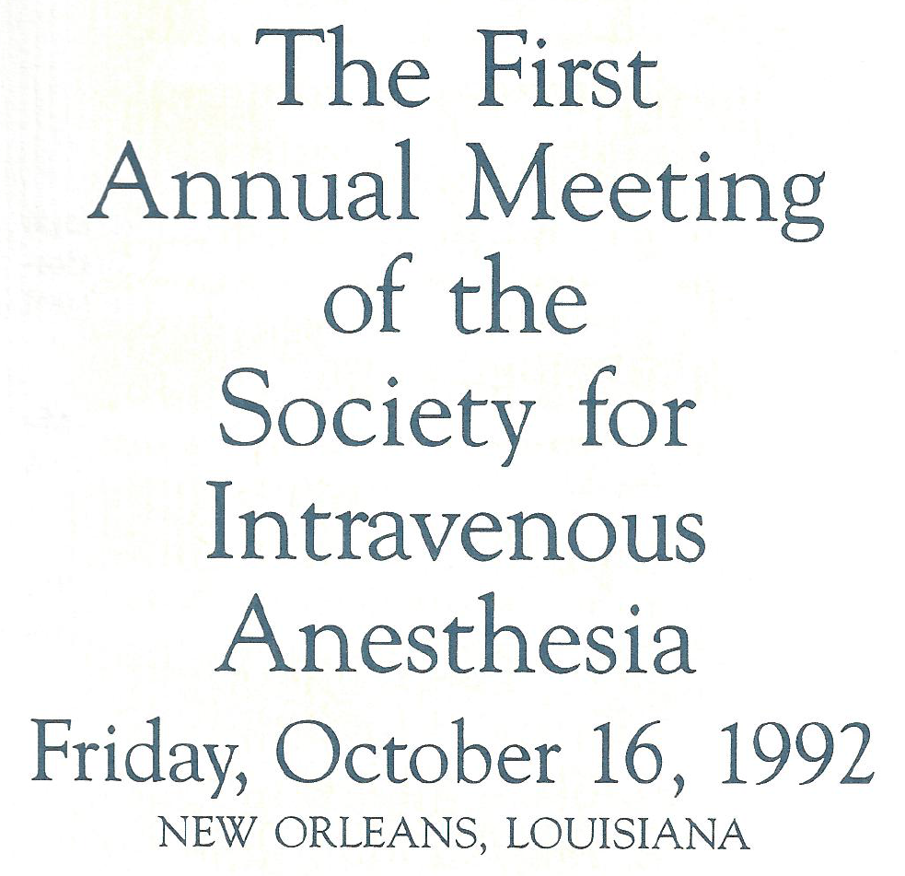
SIVA: The Birth of a New Society

Slide 13
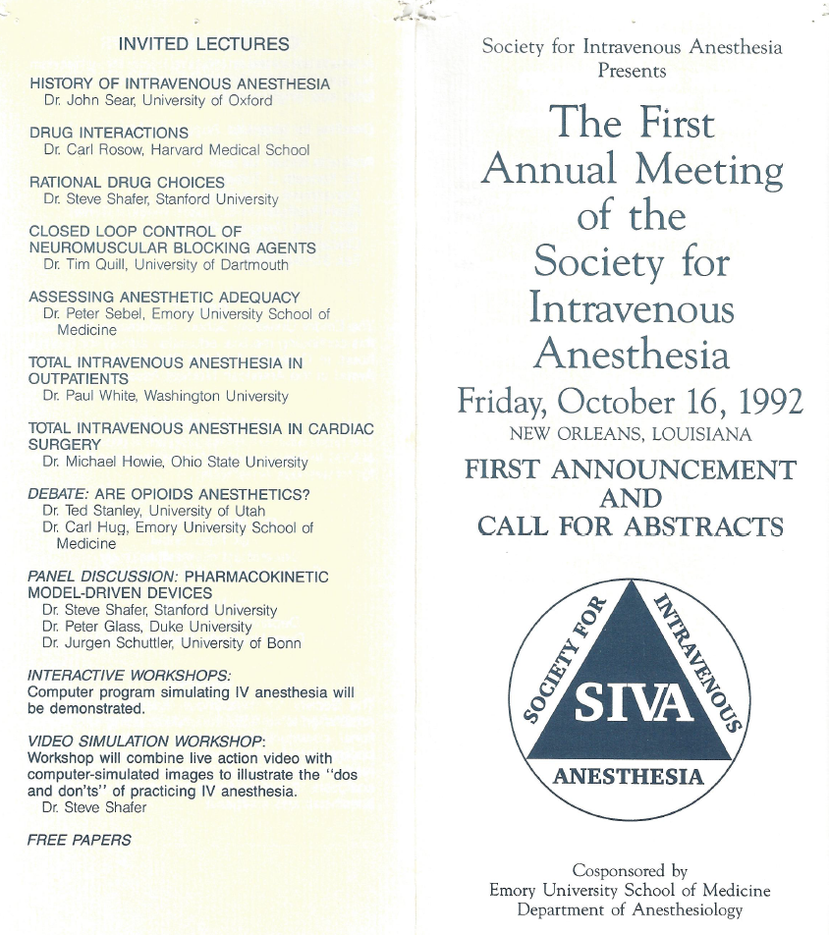
SIVA: The Birth of a New Society

Slide 14
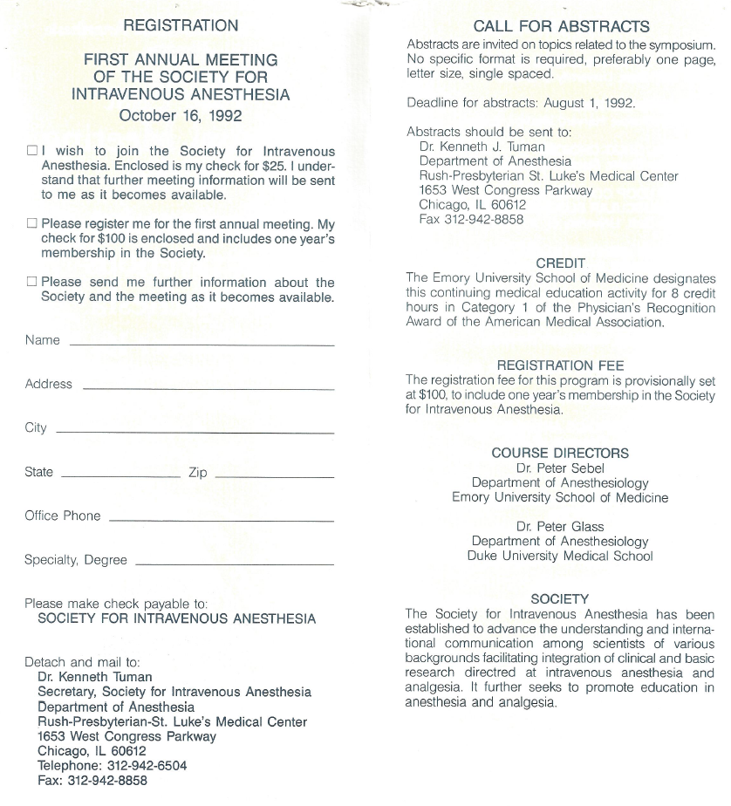
SIVA: The Birth of a New Society

Slide 15
The CME and meeting sponsorship for Third thru Seventh Annual Meetings (1994 – 1997) was provided for provided by Ohio State
The meeting Chair for all five meetings was Michael B. Howie
For the Seventh Annual Meeting (1998) he actually had assistance from Peter Glass (1996 President) and Paul White (1999 President)

Slide 16
SIVA: The Birth of a New Society
Past Presidents
1990-1991 | 2000-2001 | 2009
Elemer Zsigmond, MD | James G. Bovill, MD, PhD, FCARCSI | Thomas Schnider, MD
University of Illinois, Chicago | Uithoorn, The Netherlands | Institut für Anästhesiologie, St Gallen, Switzerland
1993 | 2002 | 2010
Tony Ivankovich, MD | John W. Sear, MA, BSc, MBBS, PhD, FFARCS, FANZCA | Pamela Flood, MD
Rush University Medical Center, Chicago | University of Oxford, UK | Columbia University
1994 | 2003 | 2011
Ted Stanley, MD | Tony Gin, MD, FANZCA | Thomas K. Henthorn, MD
University of Utah | Chinese University of Hong Kong | University of Colorado - Denver
1995 | 2004 | 2012
Peter Sebel, MBBS, PhD, MBA | Adrian W. Gelb, MB, ChB | Tom C. Krejcie, MD
Emory University, Atlanta Georgia | University of California, San Francisco | Northwestern University
1996 | 2005 | 2013
Peter Glass, MD | Talmage D. Egan, MD | Ken B. Johnson, MD
Stony Brook University, New York | University of Utah | University of Utah
1997 | 2006 | 2014
Kenneth J. Tuman, MD | Steven L. Shafer, MD | Yuguang Huang, MD
Rush University Medical Center, Chicago | Stanford University | Peking Union Medical College Hospital
1998 | 2007 | 2015
Michael B. Howie, MD | Michel Struys, MD, PhD | James M. Sonner, MD
The Ohio State University | University Medical Center Groningen, The Netherlands | University of California - San Francisco
1999 | 2008 | 2016
Paul White, MD | Tong J. Gan, MD | Vesna Jevtovic-Todorovic, MD, PhD, MBA
University of Texas | Duke University | University of Colorado - Denver

Slide 17
From SIVA to ISAP Annual Meeting Sponsors
1992 | Emory | 2001 | IARS | 2008 | SAMI
1993 | Emory | 2002 | IARS | 2009 | SAMI
1994 | Ohio State | 2003 | IARS | 2010 | SAMI
1995 | Ohio State | 2004 | IARS | 2011 | SAMI
1996 | Ohio State | 2005 | IARS | 2012 | SAMI
1997 | Ohio State | 2006 | IARS | 2013 | SAMI
1998 | Ohio State | 2007 | IARS | 2014 | SAMI
1999 | Duke |  |  | 2015 | SAMI
2000 | Utah |  |  | 2016 | SAMI

Slide 18
From SIVA to Europe and the World
Several National and International Societies for Intravenous Anaesthesia have since been established
The European Society of Intravenous Anaesthesia (EuroSIVA) was founded in 1997
On September 27-29, 2007 the `First World Congress of Total Intravenous Anaesthesia-Target Controlled Infusion' was held in Venice, Italy.

Slide 19
From SIVA to ISAP Recognizing the Expanding Scope of an International Society
From SIVA to ISAP! – A Logical Evolution
Paul F. White, PhD, MD, FANZCA
James G. Bovill, MD, PhD, FCARCSI
SIVA achieved affiliation status with the IARS in 1999
A special section in the Journal Anesthesia and Analgesia devoted exclusively to Intravenous Anesthesia was also established
This editorial in the January 2001 issue of Anesthesia and Analgesia announced the name change from the Society for IntraVenous Anesthesia to the International Society for Anaesthetic Pharmacology.

Slide 20
From SIVA to ISAP Recognizing the Expanding Scope of an International Society
The new name reflected not only the continued interest in intravenous anesthesia but also the much broader interests:
Pharmacokinetics and Pharmacodynamics –Intravenous and Inhaled Anesthetics
Anesthetic Drug Interactions
Drug Delivery Systems - TCI
Real-time Drug Concentration Predictions – Recirculatory Models
Cerebral Function Monitoring
The scope of the Society also includes basic science
Drug Receptors
Mechanisms of Action
Pharmacogenomics
Drug Development
Alternative Routes of Drug Administration
Let us recognize that anesthesiologists are excellent clinical pharmacologists
Drug effect typically takes effect shortly after administration
The drugs we use typically have very narrow therapeutic windows

Slide 21
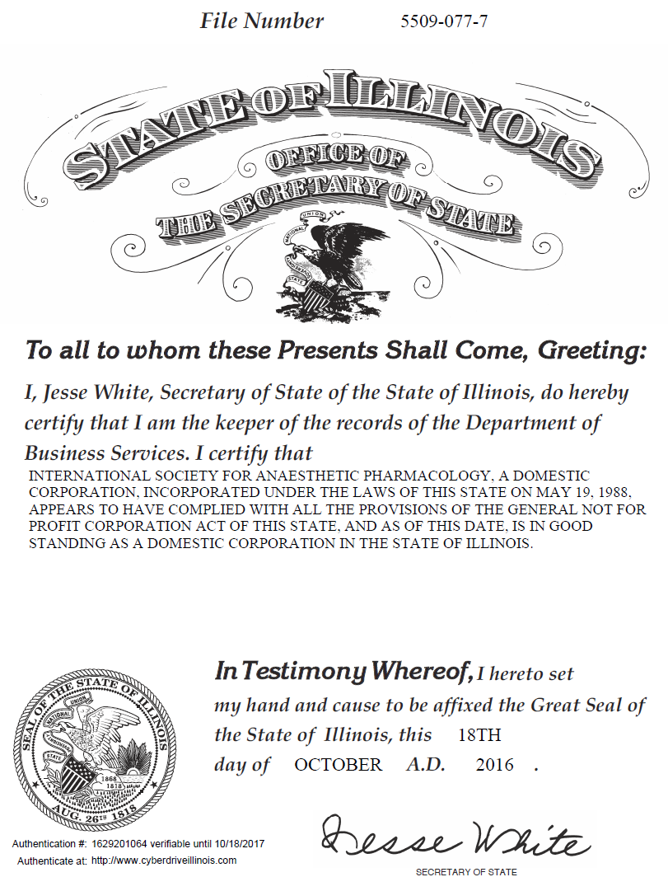
From SIVA to ISAP: The History of Anaesthesic Pharmacology
16 April 2002

Slide 22
SIVA: The Birth of a New Society
Past Presidents
1990-1991 | 2000-2001 | 2009
Elemer Zsigmond, MD | James G. Bovill, MD, PhD, FCARCSI | Thomas Schnider, MD
University of Illinois, Chicago | Uithoorn, The Netherlands | Institut für Anästhesiologie, St Gallen, Switzerland
1993 | 2002 | 2010
Tony Ivankovich, MD | John W. Sear, MA, BSc, MBBS, PhD, FFARCS, FANZCA | Pamela Flood, MD
Rush University Medical Center, Chicago | University of Oxford, UK | Columbia University
1994 | 2003 | 2011
Ted Stanley, MD | Tony Gin, MD, FANZCA | Thomas K. Henthorn, MD
University of Utah | Chinese University of Hong Kong | University of Colorado - Denver
1995 | 2004 | 2012
Peter Sebel, MBBS, PhD, MBA | Adrian W. Gelb, MB, ChB | Tom C. Krejcie, MD
Emory University, Atlanta Georgia | University of California, San Francisco | Northwestern University
1996 | 2005 | 2013
Peter Glass, MD | Talmage D. Egan, MD | Ken B. Johnson, MD
Stony Brook University, New York | University of Utah | University of Utah
1997 | 2006 | 2014
Kenneth J. Tuman, MD | Steven L. Shafer, MD | Yuguang Huang, MD
Rush University Medical Center, Chicago | Stanford University | Peking Union Medical College Hospital
1998 | 2007 | 2015
Michael B. Howie, MD | Michel Struys, MD, PhD | James M. Sonner, MD
The Ohio State University | University Medical Center Groningen, The Netherlands | University of California - San Francisco
1999 | 2008 | 2016
Paul White, MD | Tong J. Gan, MD | Vesna Jevtovic-Todorovic, MD, PhD, MBA
University of Texas | Duke University | University of Colorado - Denver

Slide 23
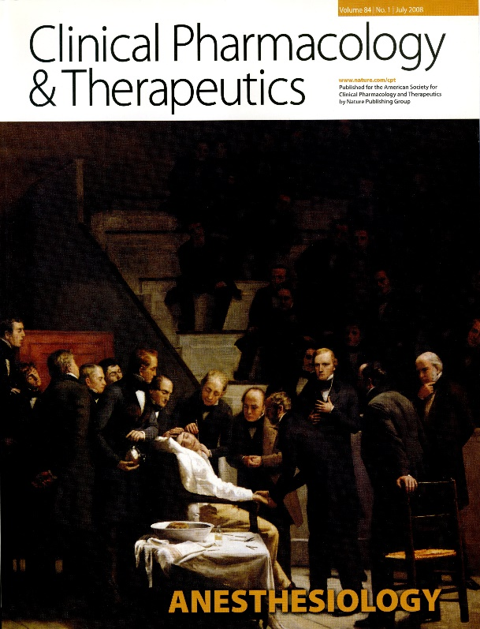
The Impact of Anesthesiology
on Clinical Pharmacology
CP&T, July 2008 with a lead editorial by Michael J. Avram, Dhanesh Gupta and Arthur J. Atkinson, Jr.
Anesthesia: A Discipline That Incorporates Clinical Pharmacology Across the DDRU (drug discovery, development, regulation, and utilization) Continuum

Slide 24
Honoring Our Colleagues - ISAP Awards
In 2004, the Board of Directors (Tom Henthorn) decided to honor members of the international community of anesthesiologists for their contributions to Anaesthetic Pharmacology.
To that end, ISAP initiated two awards (initially planned for alternate years):
Lifetime Achievement Award
Innovation in Anaesthetic Pharmacology

Slide 25
SIVA: Achievement and Innovation Awards
Past Presidents
1990-1991 | 2000-2001 | 2009
Elemer Zsigmond, MD | James G. Bovill, MD, PhD, FCARCSI | Thomas Schnider, MD
University of Illinois, Chicago | Uithoorn, The Netherlands | Institut für Anästhesiologie, St Gallen, Switzerland
1993 | 2002 | 2010
Tony Ivankovich, MD | John W. Sear, MA, BSc, MBBS, PhD, FFARCS, FANZCA | Pamela Flood, MD
Rush University Medical Center, Chicago | University of Oxford, UK | Columbia University
1994 | 2003 | 2011
Ted Stanley, MD | Tony Gin, MD, FANZCA | Thomas K. Henthorn, MD
University of Utah | Chinese University of Hong Kong | University of Colorado - Denver
1995 | 2004 | 2012
Peter Sebel, MBBS, PhD, MBA | Adrian W. Gelb, MB, ChB | Tom C. Krejcie, MD
Emory University, Atlanta Georgia | University of California, San Francisco | Northwestern University
1996 | 2005 | 2013
Peter Glass, MD | Talmage D. Egan, MD | Ken B. Johnson, MD
Stony Brook University, New York | University of Utah | University of Utah
1997 | 2006 | 2014
Kenneth J. Tuman, MD | Steven L. Shafer, MD | Yuguang Huang, MD
Rush University Medical Center, Chicago | Stanford University | Peking Union Medical College Hospital
1998 | 2007 | 2015
Michael B. Howie, MD | Michel Struys, MD, PhD | James M. Sonner, MD
The Ohio State University | University Medical Center Groningen, The Netherlands | University of California - San Francisco
1999 | 2008 | 2016
Paul White, MD | Tong J. Gan, MD | Vesna Jevtovic-Todorovic, MD, PhD, MBA
University of Texas | Duke University | University of Colorado - Denver

Slide 26
Honoring Our Colleagues - ISAP Awards
Lifetime Achievement Awards
2005: Edmond I. "Ted" Eger, II, MD
2007: Donald R. Stasnki, MD
2009: Carl E. Rosow, MD, PhD
2011: Steven L. Shafer, MD
2014: John W. Sear, MA, BSc, MBBS, PhD, FFARCS, FANZCA
2015: Johan Coetzee, BSc, MBChB, MMed(Anes), FCA(SA), PhD
2016: Talmage Egan, MD
Award for Innovation in Anaesthetic Pharmacology
2008: Helmut Schwilden, MD, PhD

Slide 27
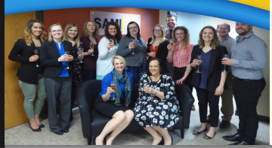
Open for Business Under New Management
ISAP, as a component society of Anesthesia and Analgesia received administrative support from the IARS. However, in 2007, the IARS central office decided to get out of the business of providing administrative support of these component societies
Tong J. Gan, president-elect and Tom Krejcie, Treasurer, were charged with finding a new management firm
Like the story of the three bears, of the ten firms identified, either the management firm was too small, or our society was too small
Enter SAMI, Svinicki Association Management, Inc.
Headed by Jane Svinicki, SAMI has been managing ISAP since 2008

Slide 28
SIVA: The Birth of a New Society
Past Presidents
1990-1991 | 2000-2001 | 2009
Elemer Zsigmond, MD | James G. Bovill, MD, PhD, FCARCSI | Thomas Schnider, MD
University of Illinois, Chicago | Uithoorn, The Netherlands | Institut für Anästhesiologie, St Gallen, Switzerland
1993 | 2002 | 2010
Tony Ivankovich, MD | John W. Sear, MA, BSc, MBBS, PhD, FFARCS, FANZCA | Pamela Flood, MD
Rush University Medical Center, Chicago | University of Oxford, UK | Columbia University
1994 | 2003 | 2011
Ted Stanley, MD | Tony Gin, MD, FANZCA | Thomas K. Henthorn, MD
University of Utah | Chinese University of Hong Kong | University of Colorado - Denver
1995 | 2004 | 2012
Peter Sebel, MBBS, PhD, MBA | Adrian W. Gelb, MB, ChB | Tom C. Krejcie, MD
Emory University, Atlanta Georgia | University of California, San Francisco | Northwestern University
1996 | 2005 | 2013
Peter Glass, MD | Talmage D. Egan, MD | Ken B. Johnson, MD
Stony Brook University, New York | University of Utah | University of Utah
1997 | 2006 | 2014
Kenneth J. Tuman, MD | Steven L. Shafer, MD | Yuguang Huang, MD
Rush University Medical Center, Chicago | Stanford University | Peking Union Medical College Hospital
1998 | 2007 | 2015
Michael B. Howie, MD | Michel Struys, MD, PhD | James M. Sonner, MD
The Ohio State University | University Medical Center Groningen, The Netherlands | University of California - San Francisco
1999 | 2008 | 2016
Paul White, MD | Tong J. Gan, MD | Vesna Jevtovic-Todorovic, MD, PhD, MBA
University of Texas | Duke University | University of Colorado - Denver

Slide 29
From SIVA to ISAP Annual Meeting Sponsors
1992 | Emory | 2001 | IARS | 2008 | SAMI
1993 | Emory | 2002 | IARS | 2009 | SAMI
1994 | Ohio State | 2003 | IARS | 2010 | SAMI
1995 | Ohio State | 2004 | IARS | 2011 | SAMI
1996 | Ohio State | 2005 | IARS | 2012 | SAMI
1997 | Ohio State | 2006 | IARS | 2013 | SAMI
1998 | Ohio State | 2007 | IARS | 2014 | SAMI
1999 | Duke |  |  | 2015 | SAMI
2000 | Utah |  |  | 2016 | SAMI

Slide 30
Under New Management - SAMI
International Society for Anesthetic Pharmacology (ISAP, 2008):
Society for Technology in Anesthesia (STA, 2008):
Wisconsin Society of Anesthesiologists (WSA, 2009):
Society of Anesthesia and Sleep Medicine (SASM, 2012):
Society of Academic Anesthesiology Associations (SAAA, 2013):
Society for Education in Anesthesia (SEA, 2013):
Society for Obstetric Anesthesia and Perinatology (SOAP, 2013):
Society of Cardiovascular Anesthesiologists Foundation (SCA, 2014):
American Society for Enhanced Recovery (ASER, 2014):
Minnesota Society of Anesthesiologists (MSA, 2016):

Slide 31
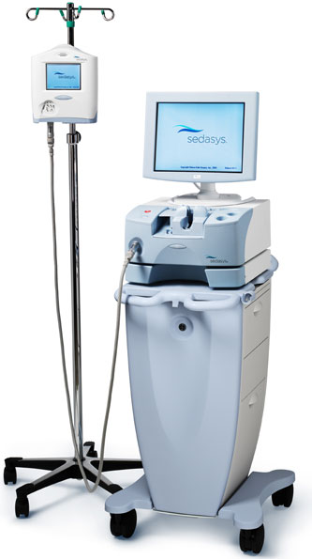
SEDASYS to the Rescue
Ethicon Endo-Surgery, a Johnson & Johnson company, announced that the FDA granted a PMA for its SEDASYS device, the first Computer-Assisted Personalized Sedation (CAPS) system for use by clinicians in endoscopy suites.
Not so fast
The FDA required that GI physicians and nurses be certified in sedation and airway management. But who will supervise the training program?
ISAP to the rescue. Thanks to Ken Johnson, Talmage Egan, Mohamed Naguib, and the ISAP-member Sedation Oversight Committee, SEDASYS got the training program they needed.

Slide 32
ISAP: Alive and Well
Past Presidents
1990-1991 | 2000-2001 | 2009
Elemer Zsigmond, MD | James G. Bovill, MD, PhD, FCARCSI | Thomas Schnider, MD
University of Illinois, Chicago | Uithoorn, The Netherlands | Institut für Anästhesiologie, St Gallen, Switzerland
1993 | 2002 | 2010
Tony Ivankovich, MD | John W. Sear, MA, BSc, MBBS, PhD, FFARCS, FANZCA | Pamela Flood, MD
Rush University Medical Center, Chicago | University of Oxford, UK | Columbia University
1994 | 2003 | 2011
Ted Stanley, MD | Tony Gin, MD, FANZCA | Thomas K. Henthorn, MD
University of Utah | Chinese University of Hong Kong | University of Colorado - Denver
1995 | 2004 | 2012
Peter Sebel, MBBS, PhD, MBA | Adrian W. Gelb, MB, ChB | Tom C. Krejcie, MD
Emory University, Atlanta Georgia | University of California, San Francisco | Northwestern University
1996 | 2005 | 2013
Peter Glass, MD | Talmage D. Egan, MD | Ken B. Johnson, MD
Stony Brook University, New York | University of Utah | University of Utah
1997 | 2006 | 2014
Kenneth J. Tuman, MD | Steven L. Shafer, MD | Yuguang Huang, MD
Rush University Medical Center, Chicago | Stanford University | Peking Union Medical College Hospital
1998 | 2007 | 2015
Michael B. Howie, MD | Michel Struys, MD, PhD | James M. Sonner, MD
The Ohio State University | University Medical Center Groningen, The Netherlands | University of California - San Francisco
1999 | 2008 | 2016
Paul White, MD | Tong J. Gan, MD | Vesna Jevtovic-Todorovic, MD, PhD, MBA
University of Texas | Duke University | University of Colorado – Denver

Slide 33
ISAP: Alive and Well
2016 - 2017 Board of Directors Slate
Officers
President | Mohamed Naguib, MD
President-Elect | David Drover, MD
Vice President | Peter Nagale, MD, MSc
Secretary | Konrad Meissner, MD
Treasurer | Mark Dershwitz, MD, PhD
Directors
Hugo Vereeke, MD, PhD
Michael Avram, PhD
Stuart Foreman, MD, PhD
Hesham Elsharkawy, MD | Nominated
Joseph Foss, MD | Nominated
Donald Mathews, MD | Nominated
Michel Struys, MD, PhD | Webmaster
Tom Krejcie, MD | Historian

Slide 34
Acknowledgements: Peter Sebel Ken Tuman Jane Svinicki

Slide 35
Thank You and Welcome to the 25th (Silver Anniversary) Annual ISAP Meeting

Slide 36
The Impact of Anesthesiology on Clinical Pharmacology
Anesthesiologist are, at least in part, responsible for the concepts of:
PK-PD Modelling
Effect Compartment or Biophase
Context-sensitive Half-time
Mechanisms of Action
Mechanisms of Anesthesia
Anesthetic-induced Cognitive Impairment – Relationship to Dementia/Alzheimer's
Anesthesia Effects on the Developing Brain (SmartTots)
Drug Delivery
Target-Controlled Infusions (TCI)
SEDASYS
Drug Effect Monitoring
Processed EEG
Drug Concentration and Effect Predictions (Heads-up Displays)

